Slide 1

Unit-2 (Part-2)
Logic Concepts

Slide 2
Axiomatic system
Axiomatic system is based on 3 axioms and one rule of deduction called Modes Ponen(MP).
Proofs are difficult and need a guess in selection of appropriate axioms.
Although minimal in structure, it is Powerful as Truth table and NDS approaches.
In this system, only two logical operators ~(not) & →(implies) are used to from a formula.
Note:
Other logical operators can be easily expressed in terms of ~ and → using equivalence laws.
For example:
A ˄ B ≡ ∼ ( ∼A ˅ ∼B) ≡ ∼( A → ∼B)
A ˅ B ≡ ∼A → B
A ↔ B ≡ ( A→B ) ˄ ( B→A ) ≡ ∼[ ( A→ B ) → ∼( B→ A ) ]

Slide 3
Axiom & Rule
Axiom 1: α → ( α → β )
Axiom 2: [α → (β → γ)] → [(α → β) → ( α→ γ )]
Axiom 3: (∼α → ∼β) → (β→ α )
Modus Ponen Rule :
Hypotheses : α → β and α, Consequent : β
Interpretation of Modus Ponen Rule: Given that α→β and α are hypotheses (assumed to be true), β is inferred (i.e true) as a consequent.

Slide 4
Axiomatic System- Example
Establish that A→C is a deductive consequence of {A→B, B→C} i.e {A→B, B→C} |- (A→C ).
Description | Formula | Comments
Theorem | {A→B, B→C} |- (A→C ). | Prove
Hypothesis (1) | A → B | 1
Hypothesis (2) | B → C | 2
Instance of Axiom 1 | (B → C) →[A→(B → C)] | 3
MP (2,3) | [A→(B → C)] | 4
Instance of Axiom 2 | [A→(B → C)]→[(A→B)→ (A→C)] | 5
MP (4,5) | (A→B)→ (A→C) | 6
MP (1,6) | (A→C) | Proved

Slide 5
Theorem
Deduction Theorem: Given that ∑ is a set of hypotheses and α and β are WFF. If β is proved from {∑ ∪ α}, then according to the deduction theorem, ( α → β ) is proved from ∑. Alternatively, we can write { ∑ ∪ α }|-β implies ∑ |-( α → β ).
Converse of Deduction Theorem : The converse of the deduction theorem can be stated as : Given ∑ |- ( α → β ), then { ∑ ∪ α } |- β is proved.

Slide 6
Useful tips
If α is given, then we can easily prove β→α for any well-formed formulae α and β.
If α→β is to be proved, then include α in the set of hypotheses ∑ and derive β from the set { ∑ ∪ α }. Then by using deduction theorem, we can conclude that α→β.

Slide 7
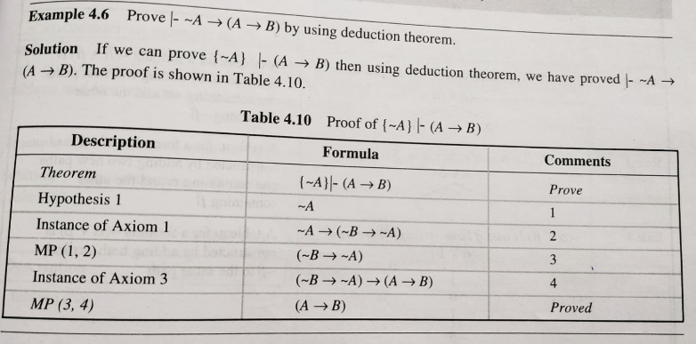
Axiomatic System Example 1:

Slide 8
Semantic Tableau System in Propositional Logic
In NDS and axiomatic systems, forward chaining approach is used for constructing proofs and derivations.
Axiomatic system, often requires a guess for the selection of appropriate axiom(s) to prove the theorem.
Implementation and derivation of forward chaining approach is difficult.
Two other approaches are:
Semantic tableau method
Resolution refutation method
In the above two approaches, proofs follow backward chaining approach.

Slide 9
Semantic Tableau System in Propositional Logic
Semantic tableau method, given set of rules will be applied systematically on a formula or a set of formulae in order to establish consistency or inconsistency.
Semantic tableau is a binary tree that can be constructed by using semantic tableau rules with a formula as a root.

Slide 10
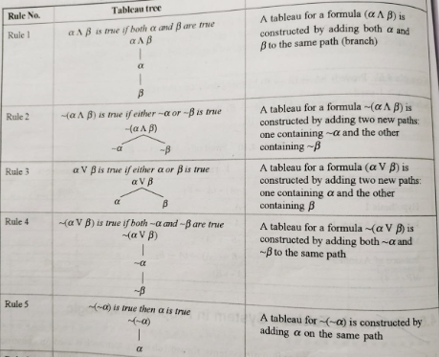
Semantic Tableau System in Propositional Logic Table. Semantic Tableau rules for αj and β

Slide 11
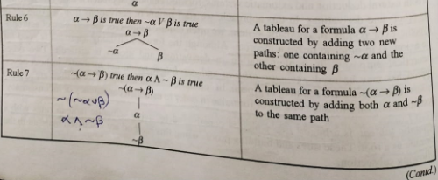
Table. Semantic Tableau rules for αj and β (Cntd..)

Slide 12
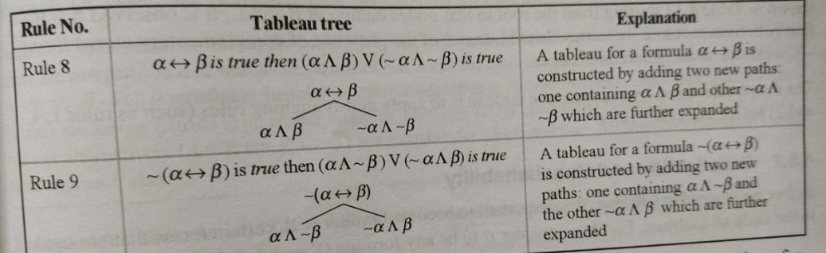
Table. Semantic Tableau rules for αj and β (Cntd..)

Slide 13
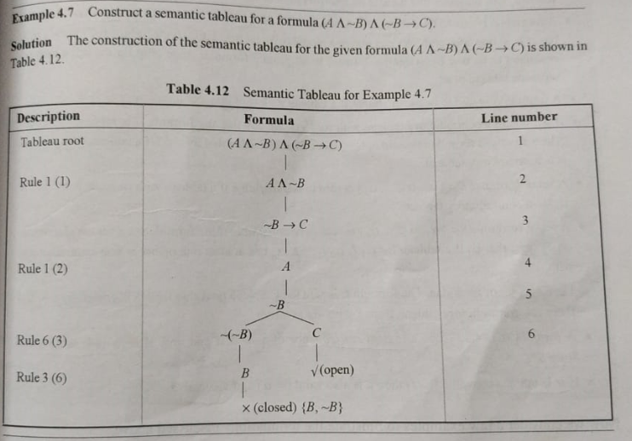
Example 1:

Slide 14
Satisfiability and Unsatisfiability
A path is said to be contradictory or closed (finished) whenever complementary atoms appear on the same path of a semantic tableau. This denotes inconsistency.
If all paths of a tableau for a given formula α are found to be closed, it is called a contradictory tableau. This indicates that there is no interpretation or model that satisfies α.
A formula α is said to be satisfiable if a tableau with root α is not a contradictory tableau, that is, it has atleast one open path. We can obtain a model or an interpretation for the formula α and is evaluated to be true by assigning T(true) to all atomic formulae appearing on the open path of semantic tableau of α.
A formula α is said to be unsatisfiable if a tableau with root α is a contradictory tableau.
If we obtain a contradictory tableau with root ∼ α, we say that the formula α is tableau provable. Alternatively, a formula α is said to be tableau provable (denoted by |- α) if a tableau with root ∼ α is a contradictory tableau.

Slide 15
Satisfiability and unsatisfiability
A set of formulae S = {α₁, α₂,…. α_{n} } is said to unsatisfiable if a tableau with root {α₁˄ α₂,… ˄α_{n} } is a contradictory tableau.
A set of formulae S={α₁, α₂,…. α_{n} } is said to satisfiable if the formulae in a set are simultaneously true, that is if a tableau for α₁˄ α₂,… ˄α_{n} has atleast one open (non- contradictory) path.
Let S be a set of formulae. The formulae α is said to be tableau provable from S ( denoted by S|- α) if there is a contradictory tableau from S with ∼ α as a root.
A formula α is said to be a logical consequence of a set S if and only if α is tableau provable from S.

Slide 16
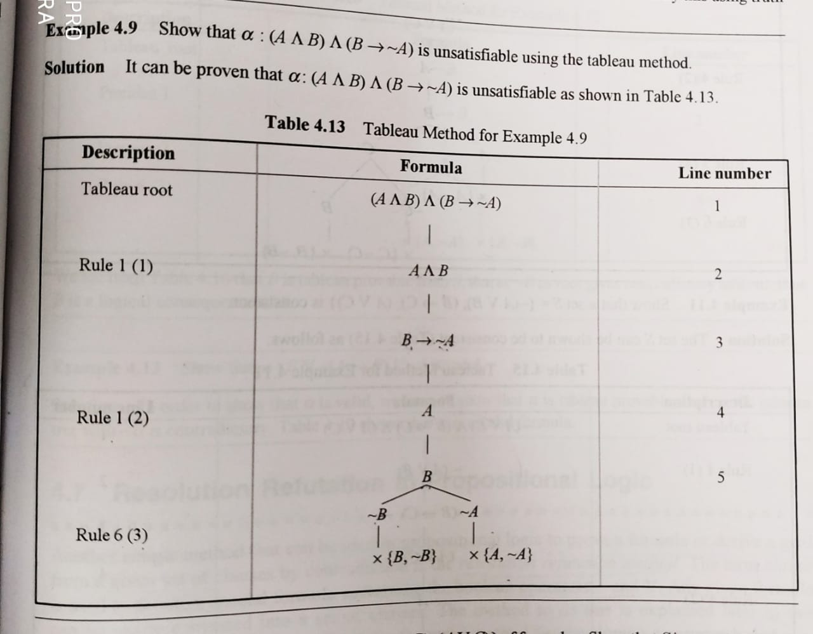
Example 1:

Slide 17
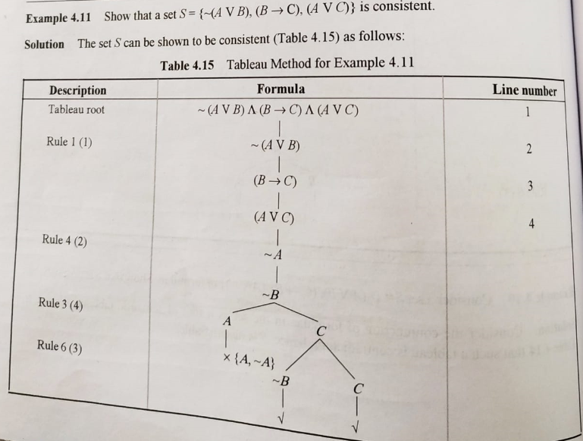
Example 2:

Slide 18
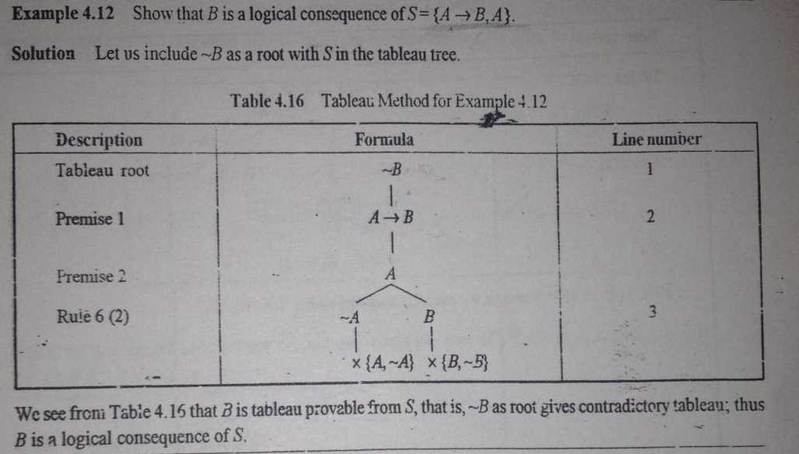
Example 3:

Slide 19
Resolution Refutation in Propositional logic
It is most favoured method for developing computer-based systems that can be used to prove theorems automatically.
This is another method that can be used in propositional logic to prove a formula or derive a goal from a given set of clauses by contradiction.
The term clause is used to denote a special formula containing the Boolean operators ~ and V.
Any given formula can be easily converted into a set of clauses.

Slide 20
Resolution Refutation in Propositional logic
It uses single inference rule, known as resolution based on modus ponen inference rule.
It is more efficient compared to NDS and Axiomatic system.
During resolution, two clauses need to be identified for the application of resolution rule:
one with a positive atom (P) and
the other with a negative atom (~P)

Slide 21
Conversion of Formula into Set of Clauses
In propositional logic, there are two normal forms:
Disjunctive Normal Form (DNF)
Conjunctive Normal Form (CNF)
A formula is said to be in normal form, if it is constrcuted using only natural connectivities {~, ^, V}.
Disjunctive Normal Form : The formula is represented as disjunction of conjunction, that is, in the form (L₁₁ ˄ ……… ˄ L_{1m}) ˅ ……. ˅ (L_{p1} ˄ ……… ˄ L_{pk})
Conjunctive Normal Form : The formula is represented as conjunction of disjunction, that is, in the form (L₁₁ ˅ ……… ˅ L_{1m}) ˄ ……. ˄ (L_{p1} ˅ ……… ˅ L_{pk}).

Slide 22
Conversion of Formula to its CNF
Eliminating double negation signs by using
∼ ( ∼ A ) ≡ A
Use De Morgan's Laws to push ∼(negation) immediately before the atomic formula.
∼ (A ˄ B ) ≡ ∼ A ˅ ∼ B
∼ (A ˅ B ) ≡ ∼ A ˄ ∼ B
Use distributive law to get CNF
A ˅ (B ˄ C ) ≡ ( A ˅ B) ˄ ( A ˅ C)
Eliminate → and ↔ by using the following equivalence laws
A → B ≡ ∼ A ˅ B
A ↔ B ≡ ( A → B) ˄ ( B → A)

Slide 23
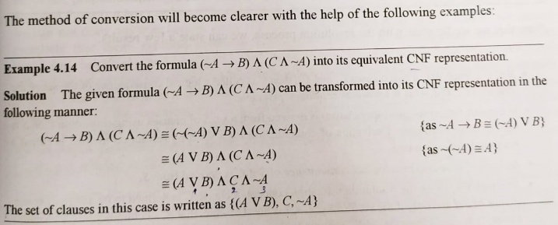
Example for Conversion of a formula to its CNF:

Slide 24
Resolution of Clauses
Two clauses C₁ and C₂, can be resolved by eliminating complementary pair of literals if any from both.
A new clause is constructed by disjunction of the remaining literals in both the clauses.
The clause C₁ and C₂ are called parent clause and the new clauses are called resolvent of C₁ and C₂.
The resolution tree is an inverted binary tree with the last node being a resolvent, which is generated as a part of the resolution process.

Slide 25
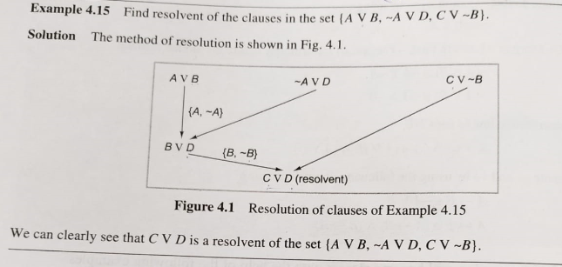
Resolution of Clauses

Slide 26
Resolution of Clauses
If C is a resolvent of two clauses C₁ and C₂, then C is called a logical consequence of the set of the clauses {C₁ , C₂}. This is known as resolution principle.
If a contradiction(or an empty clause) is derived from a set of clauses using resolution, then S is said to be satisfiable. Derivation of contradiction for a set S by resolution method is called a resolution refutation S.
A clause C is said to be a logical consequence of S if C is derived from S.
Alternatively, using the resolution refutation concept, a clause C is defined to be a logical consequence of S if and only if the set S’ = S ∪ {∼C} is unsatisfiable, that is a contradiction(or an empty clause) is deduced from the set S’, assuming that initially the set S is satisfied.

Slide 27
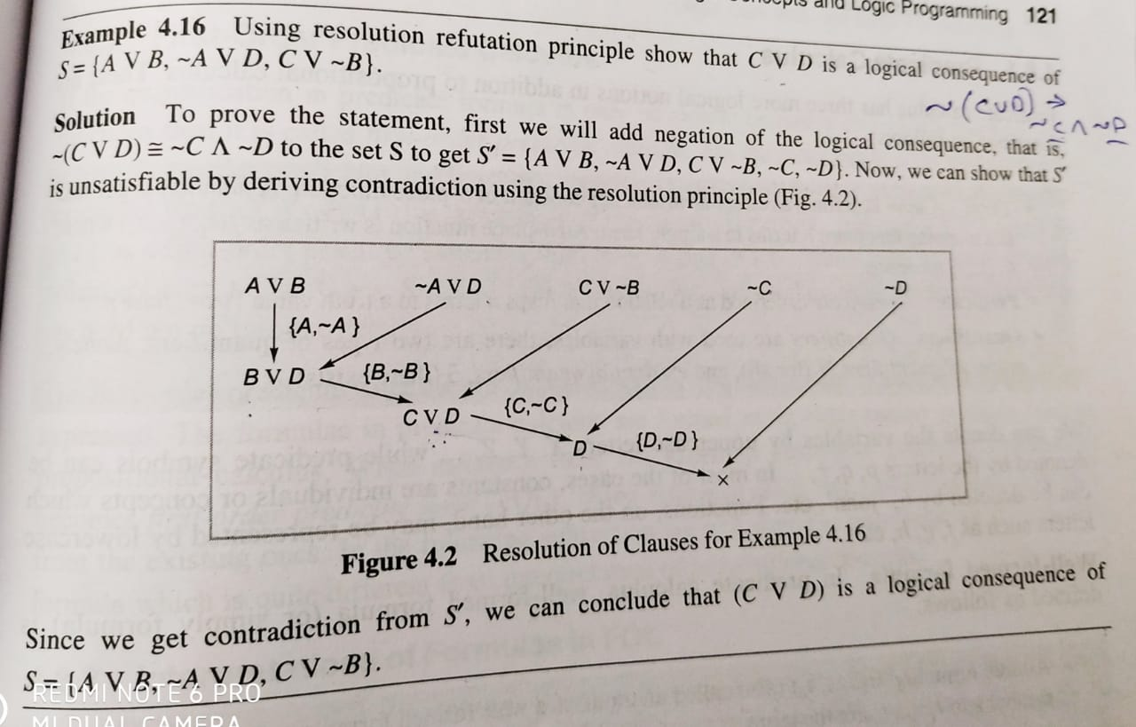
Resolution of Clauses

Slide 28
Queries ?

